Slide 1
Bus Tracking System
Android Application

Slide 2
About us
Group Name: Android Developers
Group Members:
Anurag Chitnis
Satyanarayana Chivukula
Nitesh Kumar Sharma
Gill Wasserman

Slide 3
Overview
Project Description, Motivation
Major functions, Development Environment
Team member responsibilities
Project directory structure
Project schedule – PERT and Gantt chart, MOM
Risk Management

Slide 4
Project Description
Motivation – Current UNT bus system, problems
Major Functions
tracking of buses and e-ride using GPS
Rout information and schedule on google map
Development Environment
Android Studio
GitHub

Slide 5
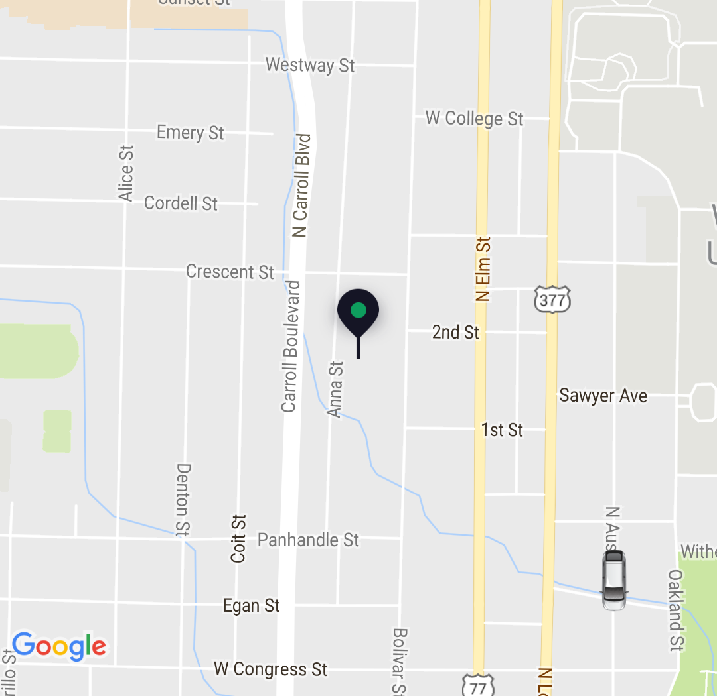
Sample user interface
Showing the bus and user location on the map

